Slide 1
Lecture 21:
Software Configuration Management (1)
http://www.youtube.com/watch?v=PxLgBx3W9Ss&feature=related choose

Slide 2
Road Map
People Management
Process Models
Management
Planning and Estimation
Scheduling and Risk Management
Requirement and Specifications
System Analysis and Design (technical)
OO Modeling and Design
Software Testing
Configuration Management
Software Quality and Maintenance
Software reuse
Management

Slide 3
The “First Law” of Software Engineering
No matter where you are in the system life cycle, the system will change, and the desire to change it will persist throughout the life cycle.
Bersoff, et al, 1980

Slide 4
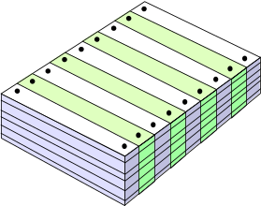
Project Changes
changes in
business requirements
changes in
technical requirements
changes in
user requirements
other
documents
software
Project
Plan
data
Test
code
Notes:
Business Requirements → high level changes in information output and input. Context level DFD changes
Technical Requirements → Hardware, performance, functional output
User requirements → Efficiency and Response time, GUI design
D
Changes to the system lead to changes in all areas of the PROJECT.
Thus changes affect many people and can cause them to have to redo their work.
Thus automated tools for planning, testing, design and documentation become even more important

Slide 5
The Software Configuration
programs
documents
The pieces
data

Slide 6
Who is affected by change?
Everyone! All the stakeholders initially identified at the start of the project and more!
  Senior management
  Line managers
  Software Engineers
  Documentation Engineers
  Customer
  User
  Technical Support.

Slide 7
Software Configuration
The items that comprise all information produced as part of the software process are collectively called a software configuration.
  Computer programs
  Documents that describe the computer programs
  Data (contained within the program or external to it)
As the software process progresses, the number of software configuration items (SCIs) grows rapidly.
An SCM Scenario

Slide 8
Software Configuration Item
  Documentation
  Test Cases
  A program’s modules or functions
  Automated tools:
  Compiler, Editor, Design Tools e.g. Visio
That are all related
Theoretically each item is uniquely defined and stored in a project database

Slide 9
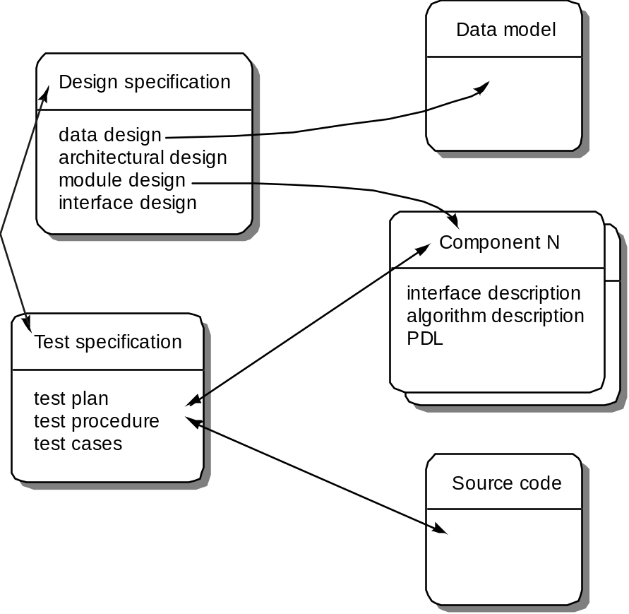
SCI’s and Change

Slide 10
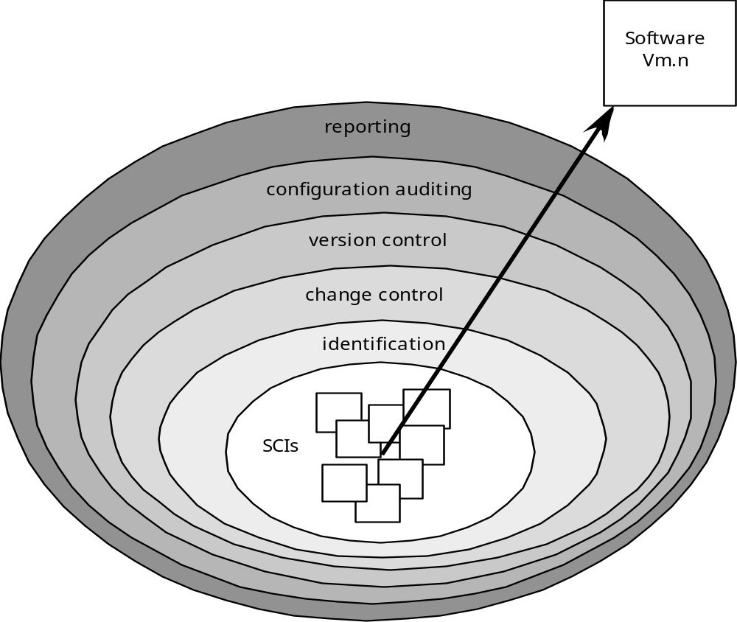
The SCM Process

Slide 11
Purpose of Configuration Management
Change introduces errors
Software is complex and changeable
  At the Application level changes seem easy to implement.
Similar products differ in subtle ways
Configuration management is for
  Versioning and variation management: identifying items
  Change management: assessing the impact of changes; approval of change
  Fault management: verifying correctness and adequacy of change

Slide 12
The need for Configuration Management
Windows Vista – 50 Million lines of code
Red Hat – 30 Million
Red Hat, Linux 4 – 61 Million
Ubuntu Repository– 121

Slide 13
Software Configuration Management
(SCM)
  How can constant change to all software project work products be monitored, controlled, and coordinated to produce consistent sets of software work products and correct release of customer deliverables?
  (Frakes, W. B. et al., Software Engineering in the Unix/C Environment)
Configuration Management is best defined in terms of its purpose.
  It helps keep order in a chaotic system
Configuration management is a set of activities
  to manage change throughout the life cycle of software.
  to ensure that the system is the correct system.
Configuration Management works by
  establishing a Baseline
  carrying out a Configuration Management Plan
  performing tasks of Identification, Control, Status Accounting and
  Audit

Slide 14
Baselines
A baseline is a specification or product that has been formally reviewed and agreed upon, that thereafter serves as the basis for further development, and that can be changed only through formal change control procedures. (IEEE Standard No. 610.12-1990)
Example:
  The elements of a Design Specification have been documented and reviewed. Errors are found and corrected. Once all parts of the specification have been reviewed, the Design Specification becomes a baseline.
The most common software baselines
  Requirements Specification
  Design Specification
  Source Code
  Test Plans / Procedures / Data
  Operational System / software tools

Slide 15
Baselines (Cont.)
A baseline is a set of critical observations (test data perhaps) or data (software, documentation etc.) used for a comparison or a control.
A baseline indicates a cutoff point in the design and development of a configuration item beyond which configuration does not evolve without undergoing strict configuration control policies and procedures.
A baseline, for example, could be the first version of a product.
The current configuration of a product can be found by applying all approved changes to the baseline.
Baselines may also be established for different stages of development, as milestones.
  the functional baseline represents the established specifications defining system requirements;
  the allocation baseline links required functions with particular items; e.g. documentation and physical items.
  the product baseline should be a deliverable system.

Slide 16
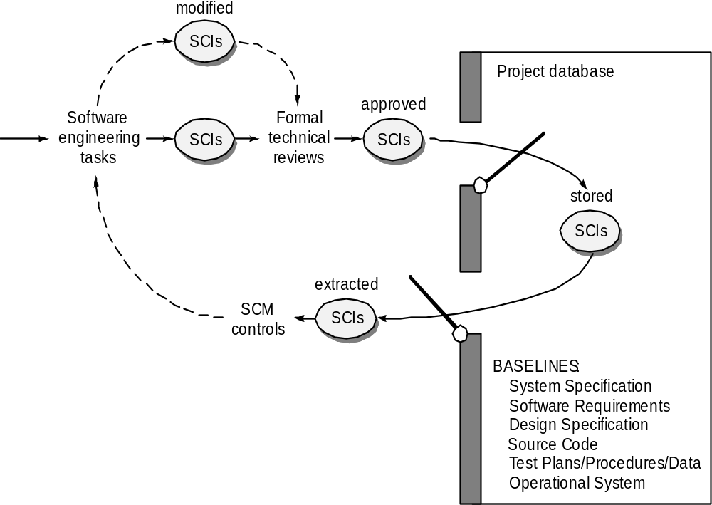
Baselines

Slide 17
Configuration Management Plan
This is a plan which describes what is to be done to implement Configuration Management.
In the simplest instance, it may just define the tasks of identification, control, accounting and audit.
It may need to be more complex, defining things like
  the composition of a Configuration Control Board
  examples of documents to be used for Configuration Management
  how the tasks are to be carried out to achieve Configuration Management
It should define the roles of all participants – designers, developers, management, the Configuration Control Board, etc.
It should document the tools to be used for Configuration Management.
It should define procedures for carrying out Configuration Management. For example, how should documentation be kept in step with any changes?
It should define emergency procedures for making changes without going through the full review process.

Slide 18
Configuration Management Tasks
Identification involves identifying the initial configuration of the system (the baseline), and subsequently, identifying changes to the baseline in a traceable way.
Configuration Control involves subjecting every proposed change to documentation, hardware and software to review for approval or disapproval. In cases where there are multiple versions (for example, Unix, Windows and Macintosh), Configuration Control ensures that the correct version is delivered.
Status Accounting is the task of reporting on the progress of development. It should be possible to locate all authorised versions of a configuration item, add in any changes with associated comments and arrive at the current state. Thus, Status Accounting depends on keeping accurate records about Configuration Items.
Audit involves checking for completeness of the Configuration Accounting information to:
  ascertain that only authorised changes have been made to the system.
  ensure planned changes have been implemented.
  ascertain the actual effects of a change.

Slide 19
Summary
Software configuration
Configuration management identifies items to be managed, controls change and verifies its effectiveness
Baselines
http://www.youtube.com/watch?v=hrpS9m2VF1c&feature=related Money

Slide 20
Readings
Chapter 27: Change Management (Pressman, 6th edition)
or
Chapter 9: Software Configuration Management (Pressman, 5th edition)

